Slide 1
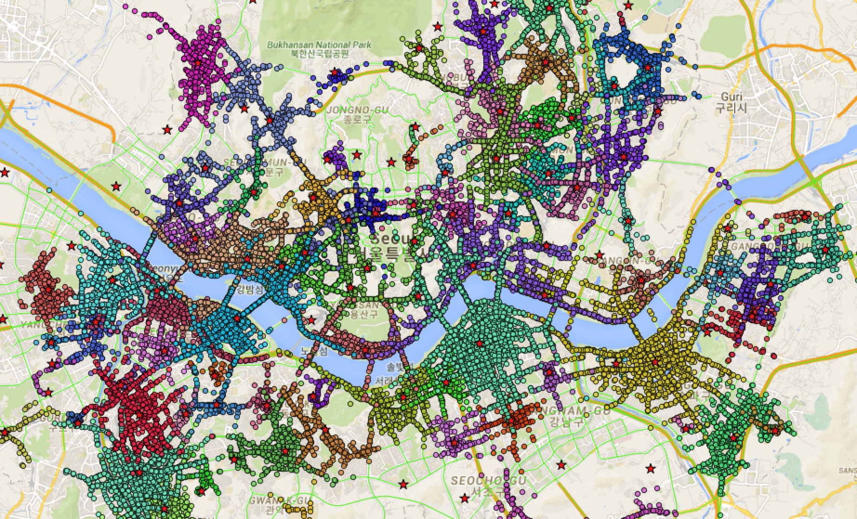
1. These Stars represent fire stations.
2. Different colored points around stars represents 5 minutes away from each fire station.

Slide 2
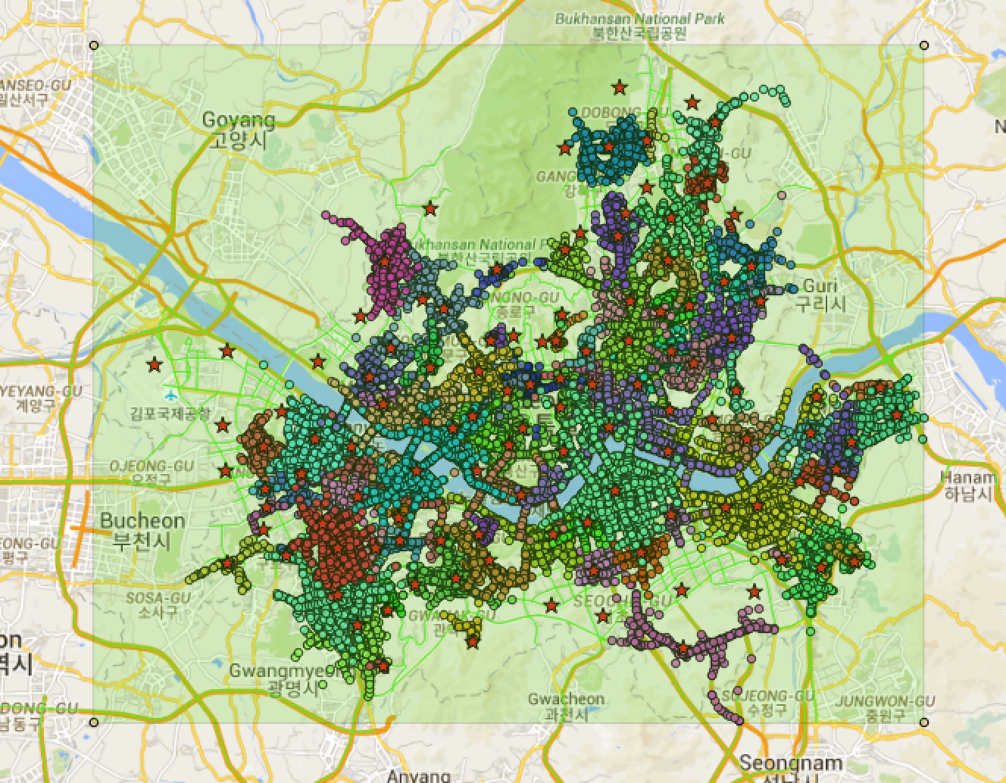
The green rectangle represents whole Seoul City I defined.

Slide 3
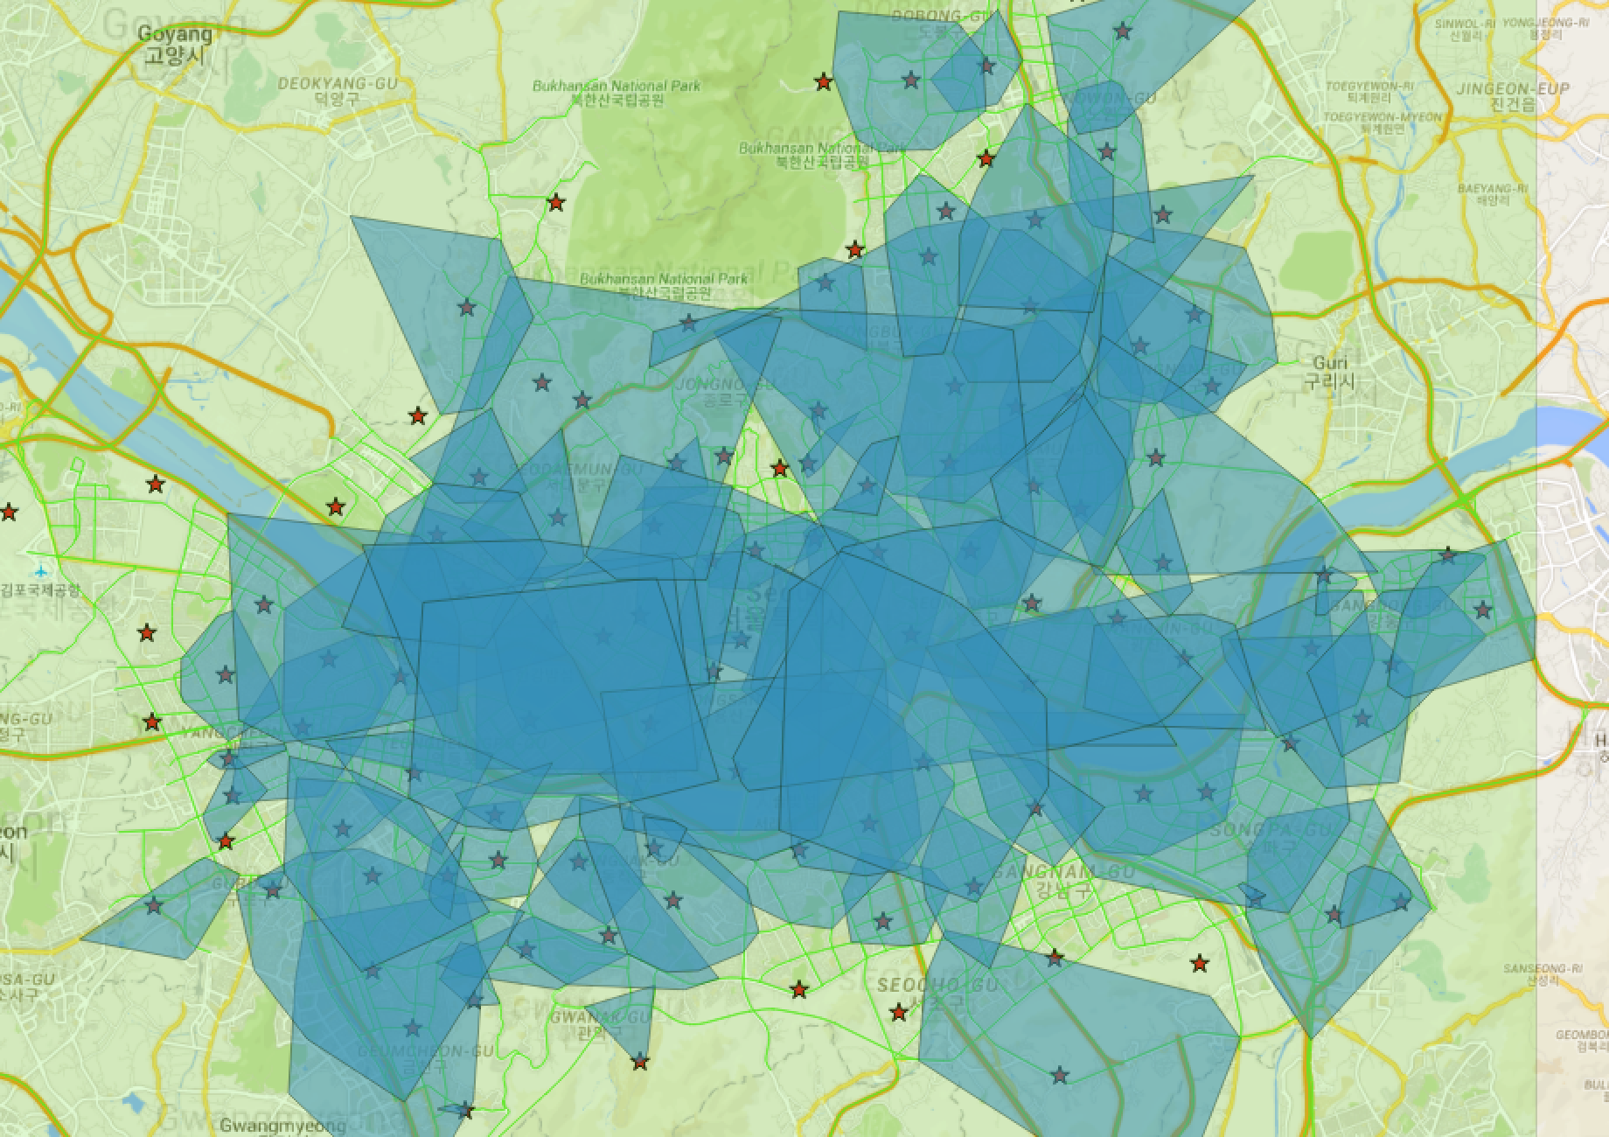
These blue convex polygons represent 5 minutes area around each fire stations.

Slide 4
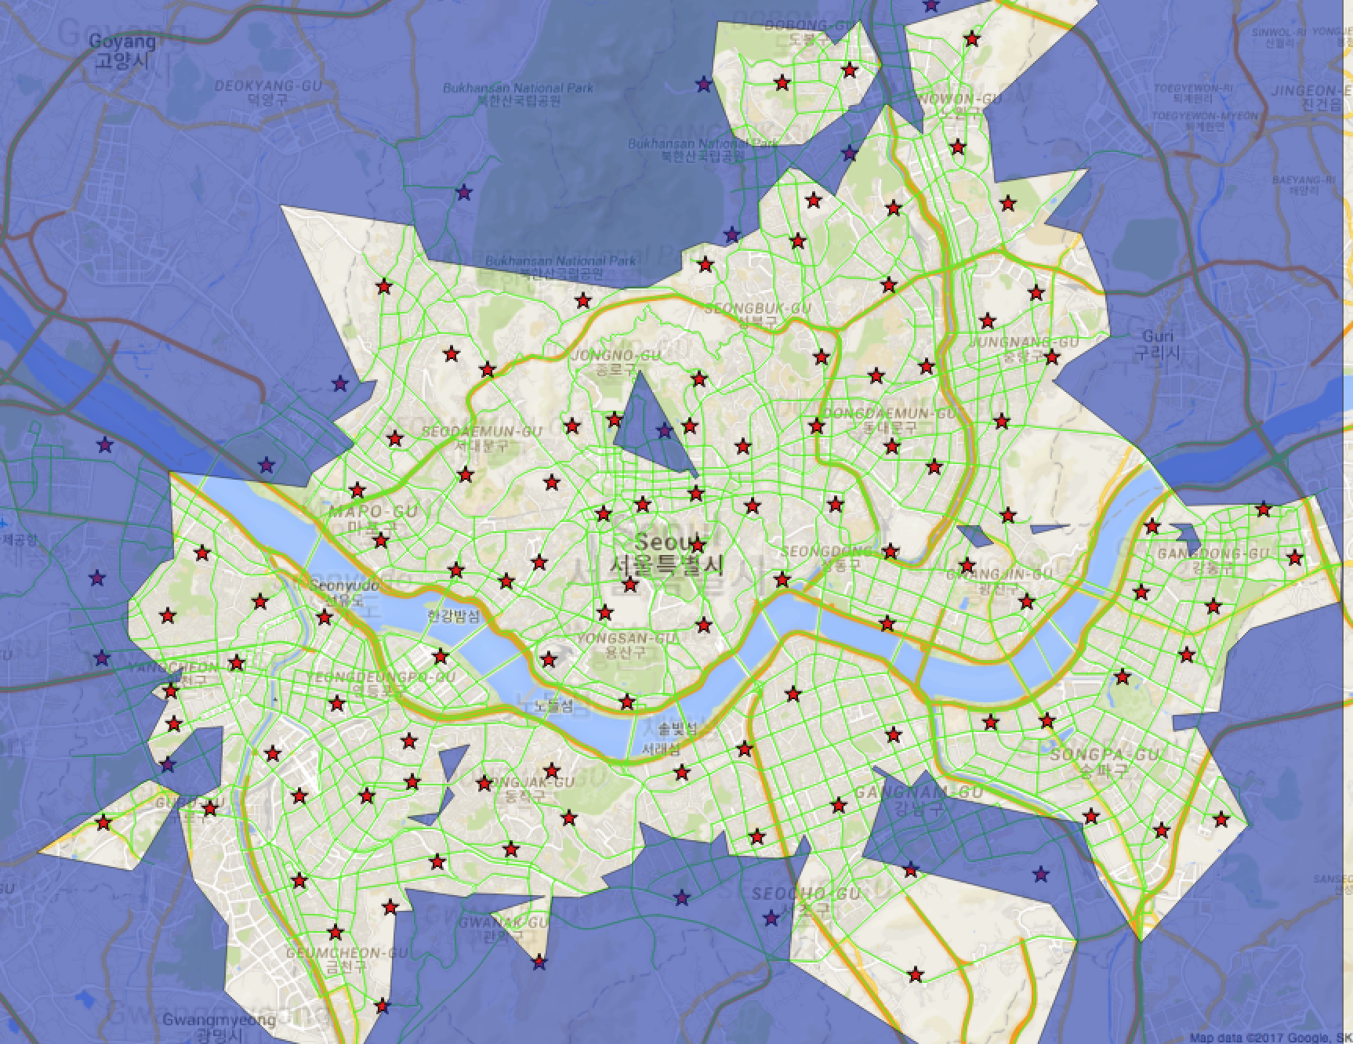
The purple area represent loopholes that can't be cover any fire stations.

Slide 5
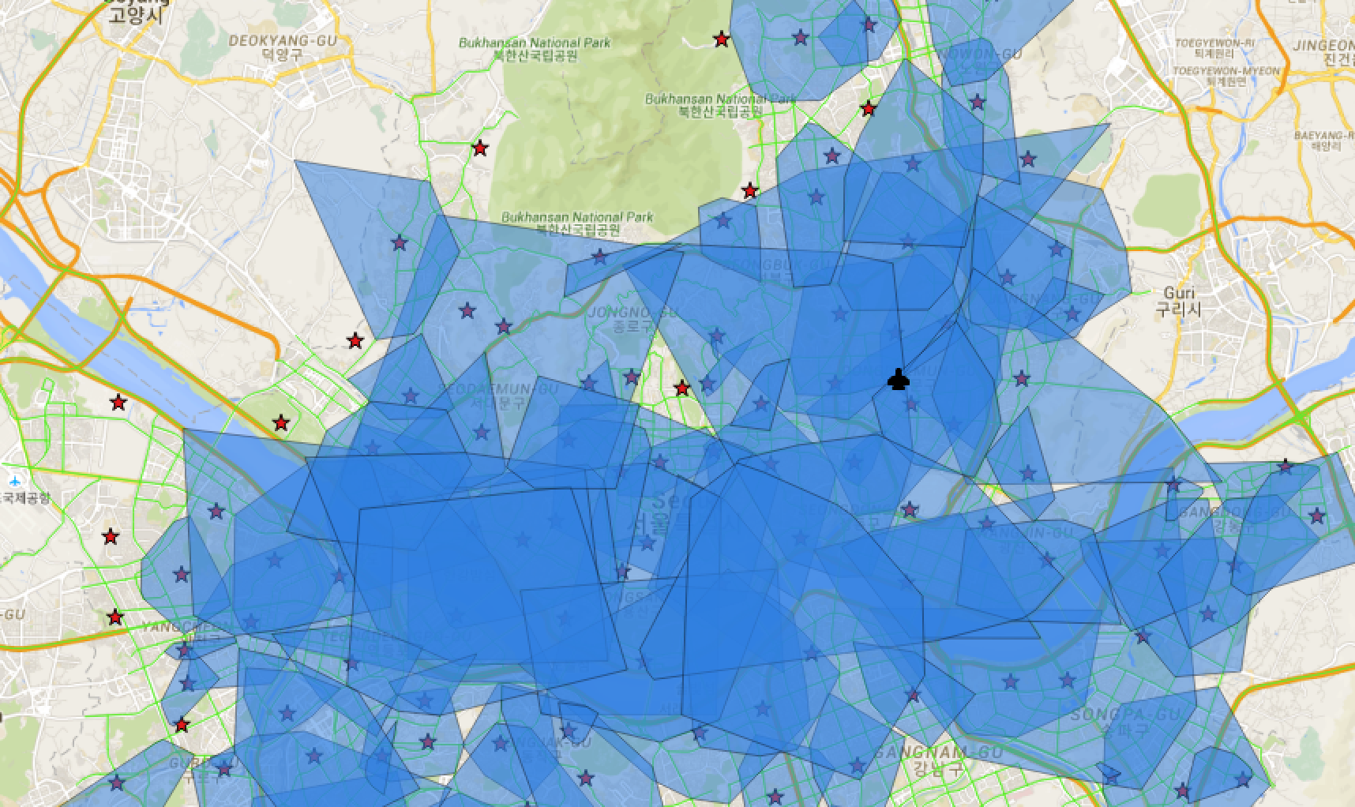
For example, this airport-shape place can be covered by three fire stations.

